Slide 1
A guide on how to use python for topic modelling
Thirunavukarasu Balasubramaniam, B.E., PhD.
Postdoctoral Fellow, Centre for Data Science,
Queensland University of Technology, Australia.
Email: thirunavukarasu.balas@qut.edu.au
Website: www.thiru.info

Slide 2
Topic modelling

Slide 3
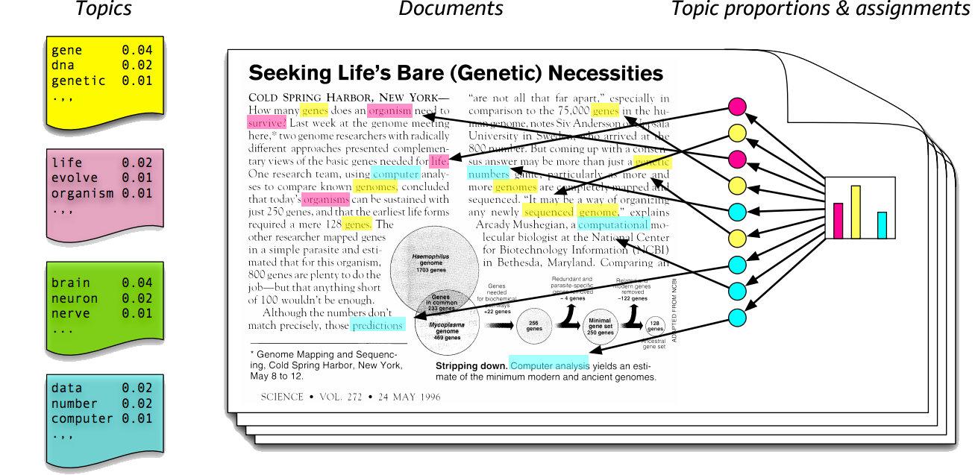
Topic modelling
https://kldavenport.com/topic-modeling-amazon-reviews/

Slide 4
Matrix Representation
Matrix is the best way of representing document-term interactions
Rows representing documents
Columns representing terms
Cells representing document x term interactions – Term frequency, tf-idf
©Thirunavukarasu Balasubramaniam

Slide 5
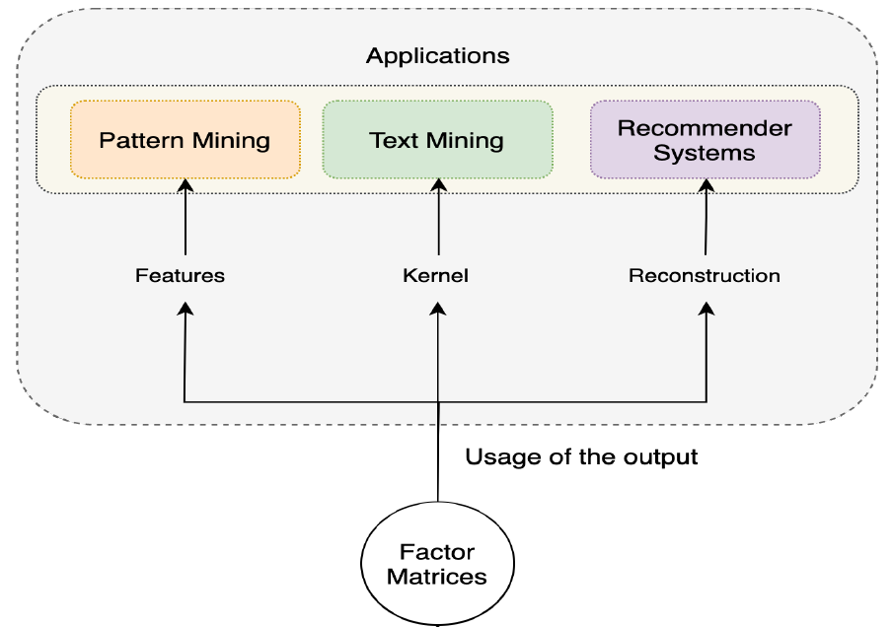
Dimensionality Reduction
A machine learning technique
Multi-purpose
©Thirunavukarasu Balasubramaniam

Slide 6
Nonnegative Matrix Factorization

Slide 7
Matrix Factorization - Example
5 x 9 = 45
Two smaller numbers
One bigger number
How it is related to Topic modelling?
©Thirunavukarasu Balasubramaniam

Slide 8






Matrix Factorization
3 | 1 | 2 | ? | 4
1 | ? | 4 | 2 | 2
1 | 3 | 4 | ? | 2
3 | 1 | 2 | 5 | 4
4 | ? | 6 | ? | 6
Given a m x n matrix, X (populated primarily by missing/zeros) – find two smaller matrices, U and V with d-dimensional features – e.g. that U is size m x d and V is size n x d – such that their product approximates X. (Adjusting d allows for more accuracy when reconstructing the original matrix).
$$≅$$
$$×$$
$V^{T}$(d x n)
$X$ (m x n)
$U$ (m x d)
X$≅U ×V^{T}= \hat{X}$
©Thirunavukarasu Balasubramaniam

Slide 9






Reconstruction
Using Non-convex Optimization
(Topic for Another Day)
Values for these matrices?
4 | 5 | 3 | 5 | 3
1 | 3 | 5 | 3 | 5
2 | 3 | 4 | 2 | 4
4 | 5 | 3 | 5 | 3
4 | 3 | 1 | 2 | 1
$$×$$
$$≅$$
$V^{T}$(d x n)
$U$ (m x d)
$\hat{X}$ (m x n)
$$U ×V^{T}= \hat{X}$$
©Thirunavukarasu Balasubramaniam

Slide 10
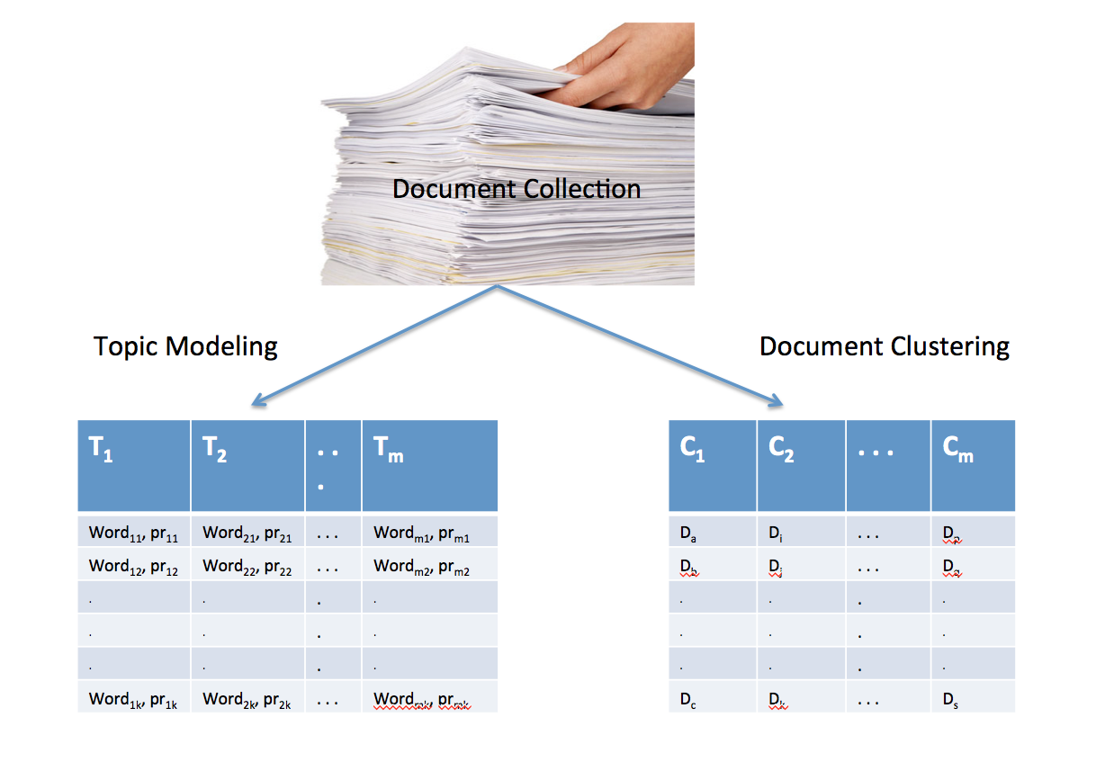
Document Clustering/Topic modelling – Social media data
Documents/tweets
https://iksinc.online/2016/05/16/topic-modeling-and-document-clustering-whats-the-difference/
©Thirunavukarasu Balasubramaniam

Slide 11
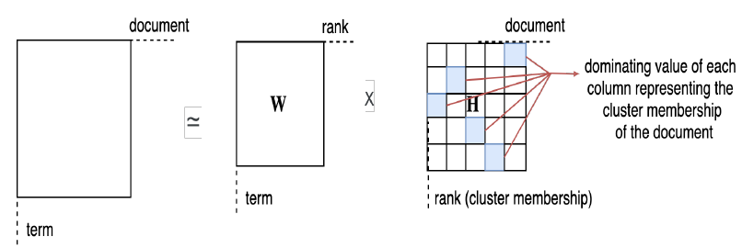
Algorithms
LDA
Nonnegative Matrix Factorization
Nonnegative Tensor Factorization

Slide 12
Coding
GitHub link:
https://github.com/thirubs/topic-modelling-using-NMF/blob/main/Topic%20modelling%20using%20python.ipynb
Collect data
Store/load the data
Data cleaning
Data representation
NMF algorithm implementation
Visualization
Sample Dataset:
https://github.com/thirubs/topic-modelling-using-NMF

Slide 13
Cautions
Basic preparations only!
Extensive and advanced techniques/algorithms will always provide better results
Memory and time complexity
Evaluation

